Slide 1

Introduction

Slide 2
Introduction to
COBOL

Slide 3
COBOL
COBOL is an acronym which stands for
Common Business Oriented Language.
The name indicates the target area of COBOL applications.
COBOL is used for developing business, typically file-oriented, applications.
It is not designed for writing systems programs. You would not develop an operating system or a compiler using COBOL.

Slide 4
COBOL Coding Rules
All COBOL programs must be structured in this way:
Columns 1 - 6: Used for sequence numbers or page and line numbers. This is optional and was previously used for sequence checking when programs were punched into cards.
Column 7: Used for continuations, comments, or starting a new page. Placing a * in column 7 denotes that line as being a comment. Placing a / in column 7 causes the printer to skip to a new page when printing the source listing, and this column can also be used to continue nonnumeric literal.
Columns 8 - 11: Known as "Area A"; entries such as DIVISION, SECTION, and paragraph-names must begin in Area A.
Columns 12 - 72: Known as "Area B"; most COBOL entries including PROCEDUREDIVISION statements and sentences are coded in Area B. Columns 73 - 80: Used for program identification (this is optional.)

Slide 5
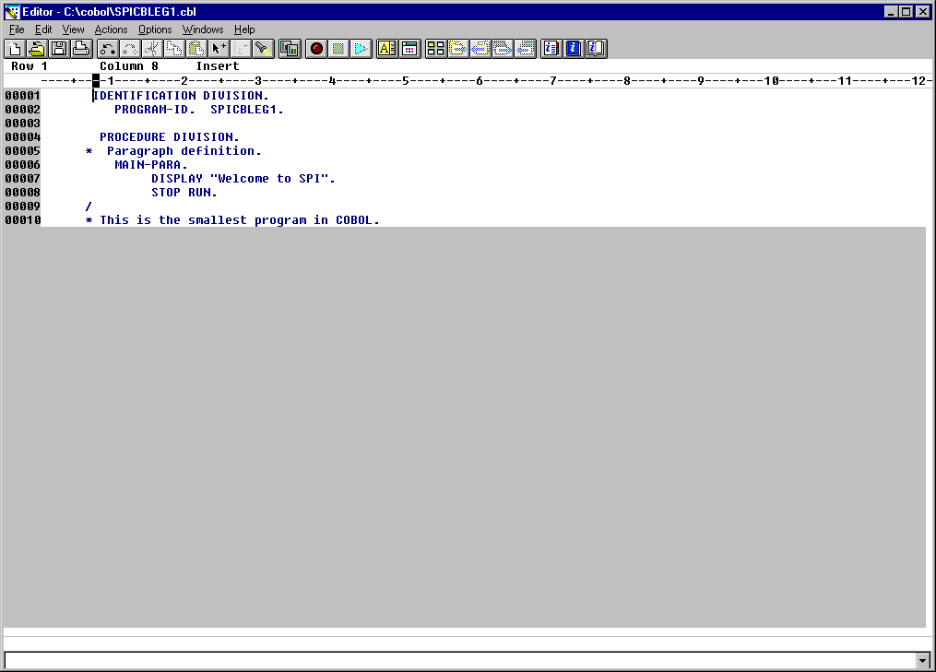
Start/ Programs/ VisualAge COBOL for Windows/ Program Editor

Slide 6
Four Divisions
Identification Division
  This DIVISION is used to supply information about the program to the programmer and to the compiler.
Environment Division
  This DIVISION describes to the compiler the environment in which the program will run.
Data Division
  As the name suggests, the DATA DIVISION is used to provide the descriptions of most of the data to be processed by the program.
Procedure Division
  This division contains all instructions necessary for reading the input, processing it, and creating the desired output.
Although some of the divisions may be omitted the sequence in which the DIVISIONS are specified is fixed and must follow the pattern shown above.

Slide 7
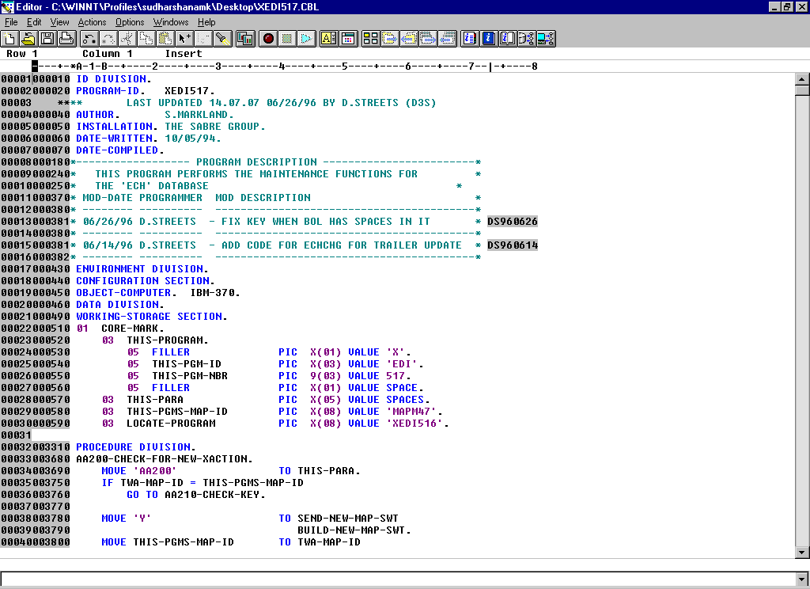
Typical COBOL Program

Slide 8
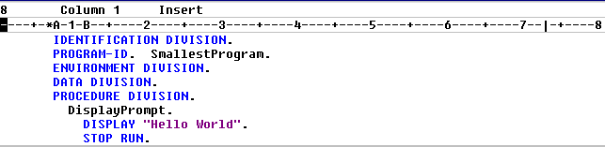
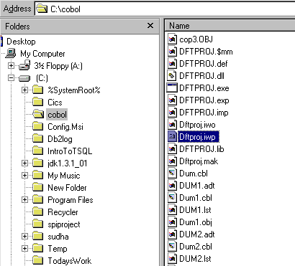
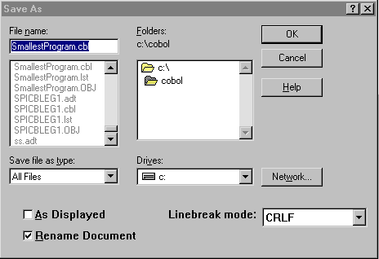
Program
To display “ Hello World ”

Slide 9
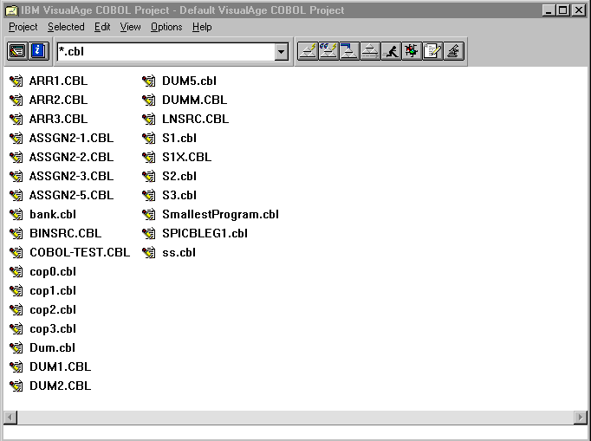
Compile Ctrl + Shft + C
Run Ctrl + Shft + R

Slide 10
IDENTIFICATION DIVISION.
The purpose of the IDENTIFICATION DIVISION is to provide information about the program to the programmer and to the compiler.
Most of the entries in the IDENTIFICATION DIVISION are directed at the programmer and are treated by the compiler as comments.
An exception to this is the PROGRAM-ID clause. Every COBOL program must have a PROGRAM-ID. It is used to enable the compiler to identify the program.
There are several other informational paragraphs in the IDENTIFICATION DIVISION but we will ignore them for the moment.

Slide 12
The DATA DIVISION
The DATA DIVISION is used to describe most of the data that a program processes.
The DATA DIVISION is divided into two main sections;
  FILE SECTION.
  WORKING-STORAGE SECTION.
The FILE SECTION is used to describe most of the data that is sent to, or comes from, the computer’s peripherals.
The WORKING-STORAGE SECTION is used to describe the general variables used in the program.

Slide 14
PROCEDURE DIVISION
The PROCEDURE DIVISION is where all the data described in the DATA DIVISION is processed and produced. It is here that the programmer describes his algorithm.
The PROCEDURE DIVISION is hierarchical in structure and consists of Sections, Paragraphs, Sentences and Statements.
Only the Section is optional. There must be at least one paragraph, sentence and statement in the PROCEDURE DIVISION.
In the PROCEDURE DIVISION paragraph and section names are chosen by the programmer. The names used should reflect the processing being done in the paragraph or section.

Slide 16
Sections
A section is a block of code made up of one or more paragraphs.
A section begins with the section name and ends where the next section name is encountered or where the program text ends.
A section name consists of a name devised by the programmer or defined by the language followed by the word SECTION followed by a full stop.
  First SECTION.
  FILE SECTION.

Slide 17
Paragraphs
Each section consists of one or more paragraphs.
A paragraph is a block of code made up of one or more sentences.
A paragraph begins with the paragraph name and ends with the next paragraph or section name or the end of the program text.
The paragraph name consists of a name devised by the programmer or defined by the language followed by a full stop.
    Main-Para.
    Exit-Main.

Slide 18
Sentences and Statements.
A paragraph consists of one or more sentences.
A sentence consists of one or more statements and is terminated by a full stop.
  MOVE 21 TO VarRate
  COMPUTE VarAmount = ProductCost * VatRate.
  DISPLAY "Enter name " WITH NO ADVANCING
  ACCEPT StudentName
  DISPLAY "Name entered was " StudentName.
A statement consists of a COBOL verb and an operand or operands.
  SUBTRACT Tax FROM GrossPay GIVING NetPay
  READ StudentFile
  AT END SET EndOfFile TO TRUE
  END-READ

Slide 19
A Full COBOL program.
SPITRGEG1
IDENTIFICATION DIVISION.
PROGRAM-ID. SPICBLEG2.
AUTHOR. Sudharshana.
DATA DIVISION.
WORKING-STORAGE SECTION.
01 WS-NAME PIC X(20).
01 WS-SAL PIC 9(6).
PROCEDURE DIVISION.
MAIN-PARA.
DISPLAY "Employee Name = " WITH NO ADVANCING.
ACCEPT WS-NAME.
DISPLAY "Employee SALARY = " WITH NO ADVANCING.
ACCEPT WS-SAL.
DISPLAY "Employee Name = ", WS-NAME.
DISPLAY "Employee SALARY = ", WS-SAL.
STOP " "
STOP RUN.

Slide 20
Structure of COBOL programs.
Program
Divisions
Section(s)
Paragraph(s)
Sentence(s)
Statement(s)

Slide 21
COBOL coding rules
Almost all COBOL compilers treat a line of COBOL code as if it contained two distinct areas. These are known as;
Area A and Area B
When a COBOL compiler recognizes these two areas, all division, section, paragraph names, FD entries and 01 level numbers must start in Area A. All other sentences must start in Area B.
Area A is four characters wide and is followed by Area B.

Slide 22
Name Construction.
All user defined names, such as data names, paragraph names, section names and mnemonic names, must adhere to the following rules;
  They must contain at least one character and not more than 30 characters.
  They must contain at least one alphabetic character and they must not begin or end with a hyphen.
  They must be contructed from the characters A to Z, the number 0 to 9 and the hyphen.
  e.g. TotalPay, Gross-Pay, PrintReportHeadings, Customer10-Rec
All data-names should describe the data they contain.
All paragraph and section names should describe the function of the paragraph or section.

Slide 23
Describing DATA.
There are basically three kinds of data used in COBOL programs;
ŒVariables.
Literals.
ŽFigurative Constants.
Unlike other programming languages, COBOL does not support user defined constants.

Slide 24
Data-Names / Variables
A variable is a named location in memory into which a program can put data and from which it can retrieve data.
A data-name or identifier is the name used to identify the area of memory reserved for the variable.
Variables must be described in terms of their type and size.
Every variable used in a COBOL program must have a description in the DATA DIVISION.

Slide 25
Using Variables
01 StudentName PIC X(6) VALUE SPACES.
MOVE “RAMA" TO StudentName.
DISPLAY "My name is ", StudentName.
StudentName

Slide 26
Using Variables
01 StudentName PIC X(6) VALUE SPACES.
MOVE "JOHN" TO StudentName.
DISPLAY "My name is ", StudentName.
StudentName
R A M A

Slide 27
Using Variables
01 StudentName PIC X(6) VALUE SPACES.
MOVE "JOHN" TO StudentName.
DISPLAY "My name is ", StudentName.
StudentName
My name is RAMA
J O H N

Slide 28
COBOL ‘PICTURE’ Clause symbols
To create the required ‘picture’ the programmer uses a set of symbols.
The following symbols are used frequently in picture clauses;
  9 (the digit nine) is used to indicate the occurrence of a digit at the corresponding position in the picture.
  X (the character X) is used to indicate the occurrence of any character from the character set at the corresponding position in the picture
  V (the character V) is used to indicate position of the decimal point in a numeric value! It is often referred to as the “assumed decimal point” character.
  S (the character S) indicates the presence of a sign and can only appear at the beginning of a picture.

Slide 29
COBOL ‘PICTURE’ Clauses
Some examples
  PICTURE 999 a three digit (+ive only) integer
  PICTURE S999 a three digit (+ive/-ive) integer
  PICTURE XXXX a four character text item or string
  PICTURE 99V99 a +ive ‘real’ in the range 0 to 99.99
  PICTURE S9V9 a +ive/-ive ‘real’ in the range ?
If you wish you can use the abbreviation PIC.
Numeric values can have a maximum of 18 (eighteen) digits (i.e. 9’s).
The limit on string values is usually system-dependent.

Slide 30
Abbreviating recurring symbols
Recurring symbols can be specified using a ‘repeat’ factor inside round brackets
  PIC 9(6) is equivalent to PICTURE 999999
  PIC 9(6)V99 is equivalent to PIC 999999V99
  PICTURE X(10) is equivalent to PIC XXXXXXXXXX
  PIC S9(4)V9(4) is equivalent to PIC S9999V9999
  PIC 9(18) is equivalent to PIC 999999999999999999

Slide 31
Declaring DATA in COBOL
DATA DIVISION.
WORKING-STORAGE SECTION.
01 Num1 PIC 999 VALUE ZEROS.
01 VatRate PIC V99 VALUE .18.
01 StudentName PIC X(10) VALUE SPACES.
DATA
Num1 VatRate StudentName
000
.18
In COBOL a variable declaration consists of a line containing the following items;
ŒA level number.
A data-name or identifier.
ŽA PICTURE clause.
We can give a starting value to variables by means of an extension to the picture clause called the value clause.

Slide 32
COBOL Literals.
String/Alphanumeric literals are enclosed in quotes and may consists of alphanumeric characters
  e.g. "Michael Ryan", "-123", "123.45"
Numeric literals may consist of numerals, the decimal point and the plus or minus sign. Numeric literals are not enclosed in quotes.
  e.g. 123, 123.45, -256, +2987

Slide 33
Figurative Constants
COBOL provides its own, special constants called Figurative Constants.
SPACE or SPACES = ◻
ZERO or ZEROS or ZEROS = 0
QUOTE or QUOTES = "
HIGH-VALUE or HIGH-VALUES = Max Value
LOW-VALUE or LOW-VALUES = Min Value
ALL literal = Fill With Literal

Slide 34
Figurative Constants - Examples
01 GrossPay PIC 9(5)V99 VALUE 13.5.
MOVE TO GrossPay.
ZERO
ZEROS
ZEROES
GrossPay
0 0 0 1 3 5 0
⇧
●
01 StudentName PIC X(10) VALUE "MIKE".
MOVE ALL "-" TO StudentName.
StudentName
M I K E ◻ ◻ ◻ ◻ ◻ ◻

Slide 35
Figurative Constants - Examples
01 GrossPay PIC 9(5)V99 VALUE 13.5.
MOVE TO GrossPay.
ZERO
ZEROS
ZEROES
GrossPay
0 0 0 0 0 0 0
⇧
●
01 StudentName PIC X(10) VALUE "MIKE".
MOVE ALL "-" TO StudentName.
StudentName
- - - - - - - - - -
SPITRGEG2

Slide 36
Group Items/Records
WORKING-STORAGE SECTION.
01 StudentDetails PIC X(26).
StudentDetails
H E N N E S S Y R M 9 2 3 0 1 6 5 L M 5 1 0 5 5 0 F

Slide 37
Group Items/Records
WORKING-STORAGE SECTION.
01 StudentDetails.
02 StudentName PIC X(10).
02 StudentId PIC 9(7).
02 CourseCode PIC X(4).
02 Grant PIC 9(4).
02 Gender PIC X.
StudentDetails
H E N N E S S Y R M 9 2 3 0 1 6 5 L M 5 1 0 5 5 0 F
StudentName StudentId CourseCode Grant Gender

Slide 38
Group Items/Records
WORKING-STORAGE SECTION.
01 StudentDetails.
02 StudentName.
03 Surname PIC X(8).
03 Initials PIC XX.
02 StudentId PIC 9(7).
02 CourseCode PIC X(4).
02 Grant PIC 9(4).
02 Gender PIC X.
StudentDetails
H E N N E S S Y R M 9 2 3 0 1 6 5 L M 5 1 0 5 5 0 F
StudentName StudentId CourseCode Grant Gender
Surname Initials

Slide 39
LEVEL Numbers express DATA hierarchy
In COBOL, level numbers are used to decompose a structure into it’s constituent parts.
In this hierarchical structure the higher the level number, the lower the item is in the hierarchy. At the lowest level the data is completely atomic.
The level numbers 01 through 49 are general level numbers but there are also special level numbers such as 66, 77 and 88.
In a hierarchical data description what is important is the relationship of the level numbers to one another, not the actual level numbers used.

Slide 40
LEVEL Numbers express DATA hierarchy
In COBOL, level numbers are used to decompose a structure into it’s constituent parts.
In this hierarchical structure the higher the level number, the lower the item is in the hierarchy. At the lowest level the data is completely atomic.
The level numbers 01 through 49 are general level numbers but there are also special level numbers such as 66, 77 and 88.
In a hierarchical data description what is important is the relationship of the level numbers to one another, not the actual level numbers used.
01 StudentDetails.
02 StudentName.
03 Surname PIC X(8).
03 Initials PIC XX.
02 StudentId PIC 9(7).
02 CourseCode PIC X(4).
02 Grant PIC 9(4).
02 Gender PIC X.
01 StudentDetails.
05 StudentName.
10 Surname PIC X(8).
10 Initials PIC XX.
05 StudentId PIC 9(7).
05 CourseCode PIC X(4).
05 Grant PIC 9(4).
05 Gender PIC X.
=

Slide 41
Group and elementary items.
In COBOL the term “group item” is used to describe a data item which has been further subdivided.
  A Group item is declared using a level number and a data name. It cannot have a picture clause.
  Where a group item is the highest item in a data hierarchy it is referred to as a record and uses the level number 01.
The term “elementary item” is used to describe data items which are atomic; that is, not further subdivided.
An elementary item declaration consists of;
    a level number,
    a data name
    picture clause.
  An elementary item must have a picture clause.
Every group or elementary item declaration must be followed by a full stop.

Slide 42
PICTUREs for Group Items
Picture clauses are NOT specified for ‘group’ data items because the size a group item is the sum of the sizes of its subordinate, elementary items and its type is always assumed to be PIC X.
The type of a group items is always assumed to be PIC X because group items may have several different data items and types subordinate to them.
An X picture is the only one which could support such collections.

Slide 43
Assignment in COBOL
In “strongly typed” languages like Modula-2, Pascal or ADA the assignment operation is simple because assignment is only allowed between data items with compatible types.
The simplicity of assignment in these languages is achieved at the “cost” of having a large number of data types.
In COBOL there are basically only three data types,
    Alphabetic (PIC A)
    Alphanumeric (PIC X)
    Numeric (PIC 9)
But this simplicity is achieved only at the cost of having a very complex assignment statement.
In COBOL assignment is achieved using the MOVE verb.

Slide 44

The MOVE Verb
The MOVE copies data from the source identifier or literal to one or more destination identifiers.
The source and destination identifiers can be group or elementary data items.
When the destination item is alphanumeric or alphabetic (PIC X or A) data is copied into the destination area from left to right with space filling or truncation on the right.
When data is MOVEd into an item the contents of the item are completely replaced. If the source data is too small to fill the destination item entirely the remaining area is zero or space filled.

Slide 45
MOVEing Data
MOVE “RYAN” TO Surname.
MOVE “FITZPATRICK” TO Surname.
01 Surname PIC X(8).
C O U G H L A N

Slide 46
MOVEing Data
MOVE “RYAN” TO Surname.
MOVE “FITZPATRICK” TO Surname.
01 Surname PIC X(8).
R Y A N

Slide 47
MOVEing Data
MOVE “RYAN” TO Surname.
MOVE “FITZPATRICK” TO Surname.
01 Surname PIC X(8).
F I T Z P A T R I C K

Slide 48
MOVEing to a numeric item.
When the destination item is numeric, or edited numeric, then data is aligned along the decimal point with zero filling or truncation as necessary.
When the decimal point is not explicitly specified in either the source or destination items, the item is treated as if it had an assumed decimal point immediately after its rightmost character.

Slide 49
01 GrossPay PIC 9(4)V99.
GrossPay
MOVE ZEROS TO GrossPay.
MOVE 12.4 TO GrossPay.
MOVE 123.456 TO GrossPay.
MOVE 12345.757 TO GrossPay.
0 0 0 0 0 0
0 0 1 2 4 0
0 1 2 3 4 5 6
1 2 3 4 5 7 5 7
⇧
●
GrossPay
⇧
●
GrossPay
⇧
●
GrossPay
⇧
●

Slide 50
01 CountyPop PIC 999.
01 Price PIC 999V99.
CountyPop
MOVE 1234 TO CountyPop.
MOVE 12.4 TO CountyPop.
MOVE 154 TO Price.
MOVE 3552.75 TO Price.
1 2 3 4
0 1 2 4
1 5 4 0 0
3 5 5 2 7 5
⇧
●
CountyPop
⇧
●
Price
⇧
●
Price
⇧
●

Slide 51

The DISPLAY Verb
From time to time it may be useful to display messages and data values on the screen.
A simple DISPLAY statement can be used to achieve this.
A single DISPLAY can be used to display several data items or literals or any combination of these.
The WITH NO ADVANCING clause suppresses the carriage return/line feed.

Slide 52
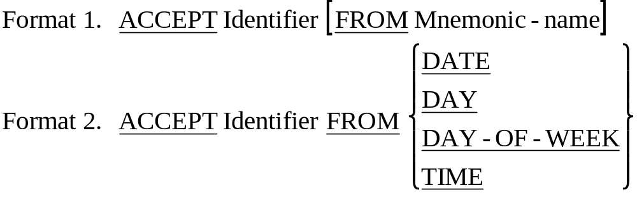
The ACCEPT verb
01 CurrentDate PIC 9(6).
* YYMMDD
01 DayOfYear PIC 9(5).
* YYDDD
01 Day0fWeek PIC 9.
* D (1=Monday)
01 CurrentTime PIC 9(8).
* HHMMSSss s = S/100

